Slide 1

NYC Shooting Incident Analysis Report
By SaeLEE, Kao Chiam

Slide 2

Agenda
1. Question 2. Data wrangling 3. Exploratory analysis/ data visualization 4. Statistical modelling 5. Conclusions

Slide 3
Question

Slide 4

Question
What can we infer about the relationship between the number of incidents and the time and place?

Slide 5
Data Wrangling

Slide 6
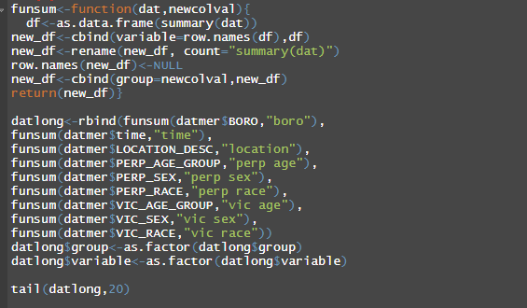
Preparing and cleaning the data
Retrieve and read the data
Convert to appropriate data types
Select important columns
Deal with missing values

Slide 7
Exploratory Analysis/ Data Visualization

Slide 8
Look important variables in the data set
Interesting differences in location and times

Slide 9
Location: Multi-dwelling areas such as apartments and public housing has high incidents

Slide 10
Location: Bronx and Brooklyn has twice as many incidents!

Slide 11
Time: late nights/early mornings show highest incidents

Slide 12
Statistical Modelling

Slide 13
Great model fit and statistical difference between times
> mod<-lm(count~BORO, data=time_dat)
> summary(mod)$adj.r.squared
[1] 0.4016487
> mod<-lm(count~time, data=time_dat)
> summary(mod)$adj.r.squared
[1] 0.1999399
> mod<-lm(count~BORO+time, data=time_dat)
> summary(mod)$adj.r.squared
[1] 0.7106939
>
---
Signif. codes: 0 ‘***’ 0.001 ‘**’ 0.01 ‘*’ 0.05 ‘.’ 0.1 ‘ ’ 1
Residual standard error: 160.2 on 92 degrees of freedom
Multiple R-squared: 0.7763, Adjusted R-squared: 0.7107
F-statistic: 11.83 on 27 and 92 DF, p-value: < 2.2e-16

Slide 14
Predicted times has a correlation of 0.88 compared to the recorded incident times
Pearson's product-moment correlation
data: time_dat2$count and time_dat2$pred_vals
t = 20.238, df = 118, p-value < 2.2e-16
alternative hypothesis: true correlation is not equal to 0
95 percent confidence interval:
0.8334897 0.9157208
sample estimates:
cor
0.8810986

Slide 15
Conclusion

Slide 16
Conclusions
Findings
Multi-dwelling complexes has highest number of reported shooting incidences
Bronx and Brooklyn has the highest incident rate
Late nights/ early mornings has the highest incident rate
Recommendations:
Stay clear of areas with high reported coincident rates
Stay clear of areas especially at late/early hours
Biases:
Focused on location and time
Data quality: how was data collected?
Data source: who collected the data and how frequently?
Notes:
Difficult for a city like NYC to enforce something like a curfew because of the sheer size of it’s population. Howver some things you can do to stay safe in theis city are
Focusing on location and time to avoid any unintended eithical issues from analysis of race for instance because there may be discrimnination going on

